Slide 1

Measurement & Scaling Concepts
Chapter 13
Business Research Methods - William G. Zikmund

Slide 2




Measurement
What?
Concept &
Operationalization
Scale
Correspondence Rules
Variables – Capture concept values
Constructs – concepts measured with multiple variables
Sudha Bhagavatheeswaran, Department of Information Technology,
SIES College of Arts, Science & Commerce (Autonomous)

Slide 3
Levels of Scale Measurement
NOMINAL
  Represents the most elementary level of measurement
  Values assigned for identification or classification purpose only
  Eg: Numbers that athletes wear
ORDINAL
  Ranking scales
  Arranged based on how much of some concept they possess.
  Eg:- Educational qualifications
INTERVAL
  Have nominal and ordinal properties
  Also capture information about differences in quantities of a concept
  Eg:- Temperature
RATIO
  Highest form of measurement
  All properties of interval scale and can represent absolute quantities Eg:- Money value
Sudha Bhagavatheeswaran, Department of Information Technology,
SIES College of Arts, Science & Commerce (Autonomous)

Slide 4
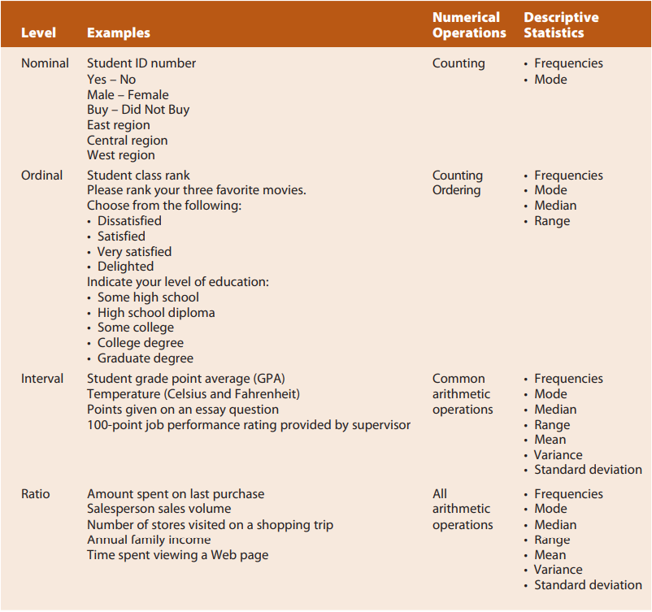

Slide 5
Mathematical and Statistical Analysis of Scales
DISCRETE MEASURE
CONTINUOUS MEASURE
The number of students in a class.
The number of workers in a company.
The number of parts damaged during transportation.
Shoe sizes
Number of languages an individual speaks.
The number of home runs in a baseball game.
The number of test questions you answered correctly.
Instruments in a shelf.
The number of siblings a randomly selected individual has.
The amount of time required to complete a project.
The height of children.
The amount of time it takes to sell shoes.
The amount of rain, in inches, that falls in a storm.
The square footage of a two-bedroom house.
The weight of a truck.
The speed of cars.
Time to wake up.
Sudha Bhagavatheeswaran, Department of Information Technology,
SIES College of Arts, Science & Commerce (Autonomous)

Slide 6
Three Criteria for Good Measurement
VALIDITY
SENSITIVITY
RELIABILITY
Sudha Bhagavatheeswaran, Department of Information Technology,
SIES College of Arts, Science & Commerce (Autonomous)

Slide 7
Reliability
an indicator of a measure’s internal consistency, concept of reliability revolves around consistency
A measure is reliable when different attempts at measuring something converge on the same result.
INTERNAL CONSISTENCY – homogeneity
  Measures:- Split- Half Method , Co-efficient alpha
TEST – RETEST RELIABILITY - administering the same scale or measure to the same respondents at two separate times to test for stability
Sudha Bhagavatheeswaran, Department of Information Technology,
SIES College of Arts, Science & Commerce (Autonomous)

Slide 8
Validity
The accuracy of a measure or the extent to which a score truthfully represents a concept
ESTABLISHING VALIDITY
  Face Validity
  Content Validity
  Criterion Validity
  Construct Validity
  Convergent Validity
  Discriminant Validity
Sudha Bhagavatheeswaran, Department of Information Technology,
SIES College of Arts, Science & Commerce (Autonomous)

Slide 9
Sensitivity
ability to accurately measure variability in a concept
“strongly agree,” “mildly agree,” “neither agree nor disagree,” “mildly disagree,” and “strongly disagree” will increase the scale’s sensitivity.
sensitivity is generally increased by adding more response points or adding scale items
Sudha Bhagavatheeswaran, Department of Information Technology,
SIES College of Arts, Science & Commerce (Autonomous)

